Slide 1
Lab 1 - Problem 1
Chase the Robot lives in the world on the next slide. We want Chase to double the number of beepers on a corner (dot) in the world. Provide the algorithm needed to double the pile of beepers. You can assume the following:
There is a finite number of beepers on the corner directly in front of Chase
Chase has an infinite number of beepers in the bag
Chase understands the following commands:
move() – takes one step forward
turnLeft() – turns left 90 degrees
pickUpBeeper() – picks up 1 beeper from the floor and puts it in the bag
putBeeper() – puts one beeper on the floor from the bag
repeat X times / End – statements between the X and the End will be repeated X times
while ? / End – statements between the ? Condition and the End will repeat as long as the ? Condition returns true
Chase knows how to do the following tests
beepersPresent() – returns true if there is at least 1 beeper on the spot Chase is standing

Slide 2
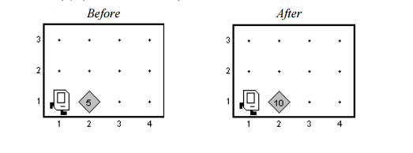
Lab 1 - Problem 1
For example, in the diagram below we started with 5 beepers and ended with 10.

Slide 3
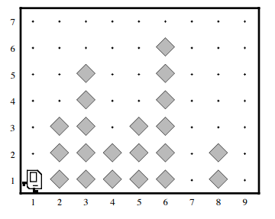
Lab 1 - Problem 2
Imagine that Chase is now living in a world that looks something like this:

Slide 4
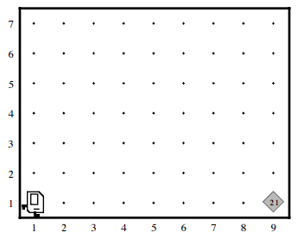
Chase’s World After Work is Complete

Slide 5
Lab 1 - Problem 2 -Requirements
On each of the avenues, there is a tower of beepers of an unknown height, although some avenues (such as 7th in the example photo) may be empty.
Chase’s job is to collect all beepers in each of these towers and put them back down on the easternmost corner of 1st street (bottom right of the world), then return to the starting position.
Chase does not have any beepers in the pouch when Chase starts.
See next slide for an “after” photo.

Slide 6
What Chase Knows How To Do
move() – Takes 1 step forward
turnLeft() – Turns 90 degrees to the left
putBeeper() – places 1 beeper at the spot Chase is standing
pickBeeper() – picks up 1 beeper at the spot Chase is standing
Chase also understands repetition (While and Repeat)

Slide 7
What Chase Knows How to Test
Test | Opposite | What it Tests
frontIsClear | frontIsBlocked | Is there a wall in front of Chase?
leftIsClear | leftIsBlocked | Is there a wall to Chase’s left?
rightIsClear | rightIsBlocked | Is there a wall to Chase’s right?
beepersPresent | noBeepersPresent | Are there beepers on this spot?
beepersInBag | noBeepersInBag | Are there beepers left in Chase’s bag?

Slide 8
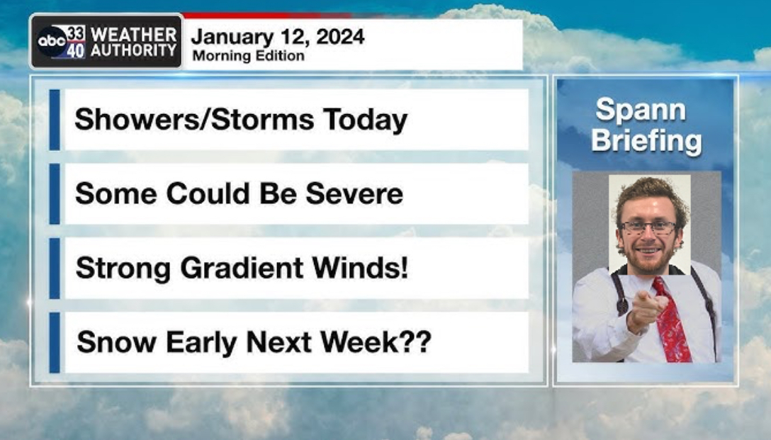
Lab 1 – Problem 3
Meteorologist Chase Spann

Slide 9
Lab 1 – Problem 3
Meteorologist Chase Spann has developed a prediction for salt needed on the road to melt snow. He needs help with his calculations.
As the expected snowfall increases, the amount of salt needed for the roads increases. There are three brackets:
20 lbs of salt per inch of snow for the first layer
30 lbs per inch of snow for the next layer
40 lbs per inch of snow exceeding the first two layers
Chase has also developed a likelihood of school cancellation. It’s 10% per centimeter of snow for the first 10 centimeters. 15% per centimeter for the next 10 centimeters and 20% a centimeter for everything beyond 20 centimeters.
The percent likelihood of school cancellation always starts off at 5%

Slide 10
Deliverables Due 1/24 @2:00
Provide the algorithm needed to satisfy the requirements of the project for Problems 1 and 2.
Provide a flow chart and IPO to satisfy the requirements of allowing Chase to enter the inches of snowfall and getting back the salt needed and chance of school cancellation.

